Slide 1

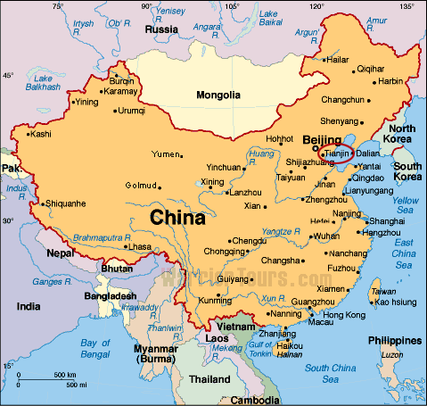
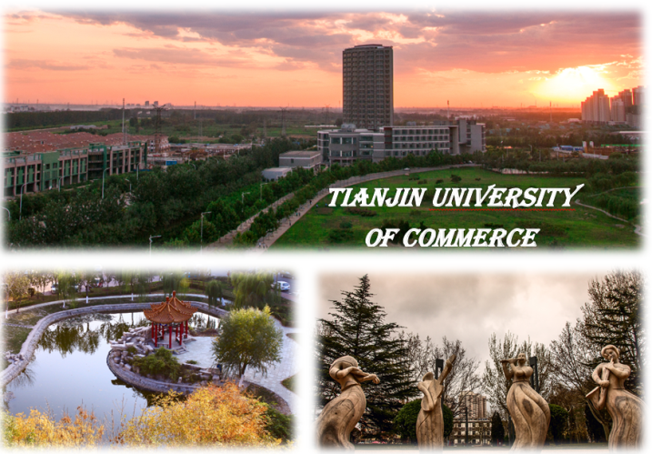

International Scientific Committee
Tianjin / 天津市
Call For Papers
Abstract due December 21, 2016
Abrudeanu M., Acad. Sciences Roumania
Aït-Mokhtar A. Univ. La Rochelle France
Alexander J. I. D., Case Western Reserve Univ. USA
Bayazitoglu Y., Rice University, USA
Belarbi R., University of La Rochelle, France
Bennacer R., Ecole Nomale Sup. Cachan, France
Benim A. C., University of Duesseldorf, Germany
Bontoux P., University of Aix Marseille, France
Bouali M., University of Mondragon, Spain
Bouhadef Kh., University USTHB, Algeria
Chai J., School of Computing and Eng., UK
Coronas A., Universitat Rovira i Virgili, Spain
Costa V., University of Aveiro, Portugal
Cotta R., Me Coppe UFRJ, Brazil
De Lemos M., Inst. Tecno. De Aeronautica, Brazil
Dombrovsky L., Inst. High Temperatures, Russia
El Ganaoui M., University of Lorraine, France
Gabsi S., University of Sfax Tunisia
Khatib J., University of Wolverhampton, UK
Lappa M., University of Napoli, Italy
Meyer JP., University of Pretoria, South Africa
Mimet A., Univ. Abd. Essaadi (UAE), Morocco
Nandakumar K., Louisiana State Univ., USA
Nunzi J. M., Queen’s University, Canada
Oka S., University of Belgrade, Serbia
Runchal A., CFD Inov. ACRI, India
Sammouda H., University of Sousse, Tunisia
Seghir Z., Ryerson University, Canada
Viera , G., University UCP, Brazil
Timchenko V., University of NSW, Australia
Yuen R., City University of Hong Kong, HK
Zhu Ji-Hong ., Northwestern Polytech. Univ., China
International
Conference on
MATERIALS
&
ENERGY
Tianjin– China
July 06-09, 2017
ICOME 2017

Slide 2
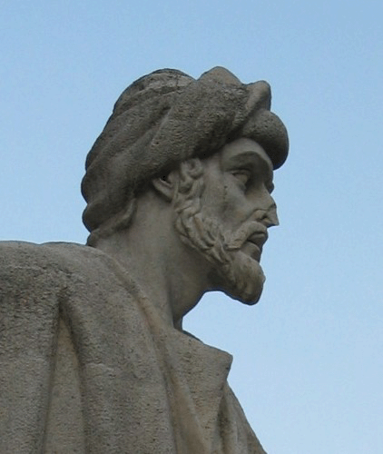








Contacts
ICOME’17 Secretary
Phone/Fax +33 1 47 40 22 39
+33 1 47 40 74 65
Email: icome17@lmt.ens-cachan.fr
Objective
Topics
Energy and Materials are the master keys of the open challenge dominating our world and its future.
ICOME’17 is a meeting dedicated to cutting edge research that addresses scientific needs of academic researchers, industrial and professionals to explore new horizons of knowledge on various topics in interlink between materials and energy applications fields. The conference will host a symposium dedicated to Eco material and sustainable construction.
ICOME’17 is scheduled to include high quality contribution during presentation sessions, and also to engage participants in interesting discussion sessions.
Accepted abstracts followed by full paper submissions will be presented as oral or posted in the corresponding conference session listed in topics (see joined list).
Paper on all aspects coupling Energy and Materials both fundamentals and applied, will be welcome.
The main topics are :
• Recent developments on innovative materials
Bio-based material / wood/ energy
Phase change materials for energy storage
Heat and Mass transfer in building materials
Drying, Imbibition, Shrinking
Materials and structures durability
Computational methods materials & Energy
Micro. and Nano. structured systems
Transport in Porous Media
Bioclimatic Architecture
Energy Systems /Efficiency/Solar/Biomass
Double diffusive convective coupling
Reactive Flow/materials and Combustion
Inverse Problems and optimization
Environmental Engineering
Benchmarking and Validation
Classical Heat and mass interlink problems
also welcome…
Deadlines/Submission
Abstract due December 21, 2016
Abstract acceptance January 22, 2017
Paper submission March 4, 2017
Review decision April 7, 2017
Submission of final paper May 17, 2017
(see web site)
After a reviewing procedure, paper will be published on edited proceeding.
High quality papers will be selected for international publication in several relevant journals, subject to review, in special (or regular) issues.
Registration
Schedule
Participation Fees is required and will include the Conference CD, attendance of all scientific sessions and meals
(Before /after April 5, 2017)
Students 275 € / 355 €
Full delegates 385 € / 465 €
Industrial 580 € / 690 €
Julu 6-9th, 2017 Keynotes, invited lecturers and parallel sessions
Topical scientific and Technical committee
Local organizing committee Social events
See the conference web-site
http://www.lmt.ens-cachan.fr/
Award:
There will be
a Special Award
Averroes Award (AA3)
Icome series/previous editions/Sponsors

